Slide 1



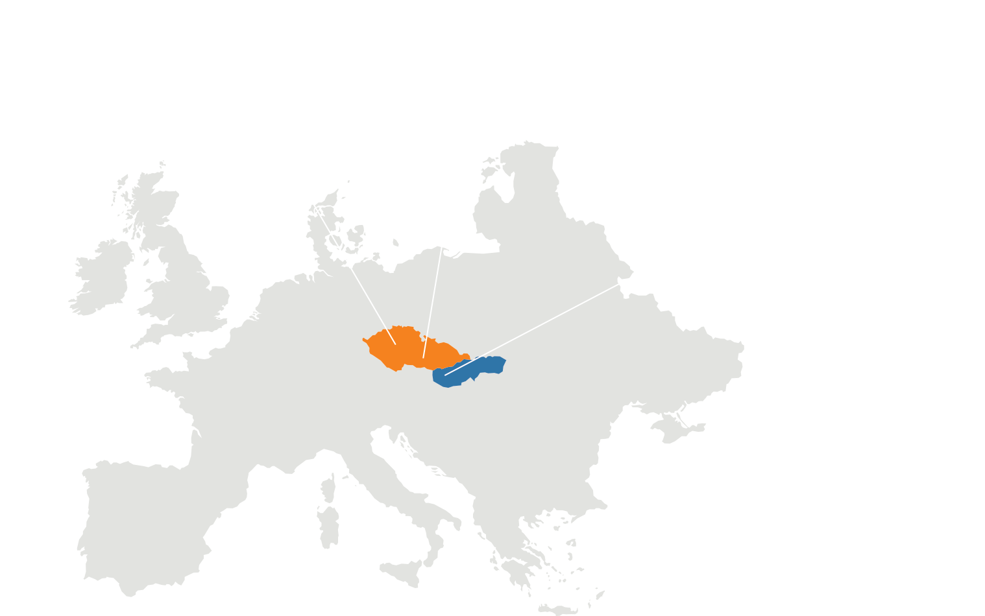




ERP
CRM
BI
What we learnt with AL Development
DMS
Tiffany Elias
Software Developer
05. 05. 2025
AI
34
37

Slide 2
ERP
Table of Contents
Introduction
What is AL language
Logo and Documents
Tables
Enums
Codeunits
Extensions
Pages
Reports
Permission Sets
Tests
README.md
GitHub
Conclusion
CRM
BI
DMS
AI
34
37

Slide 3
ERP
CRM
BI
Part 1 – What is AL & its purpose?
DMS
Tiffany Elias
Software Developer
05. 05. 2025
AI
34
37

Slide 4
ERP
CRM
BI
Part 1 – Objects in AL
DMS
Tiffany Elias
Software Developer
05. 05. 2025
AI
34
37

Slide 5
ERP
CRM
BI
Part 1 – Development Lifecycle in AL
DMS
Tiffany Elias
Software Developer
05. 05. 2025
AI
34
37

Slide 6
ERP
CRM
BI
Part 1 – Testing in AL (Basics)
DMS
Tiffany Elias
Software Developer
05. 05. 2025
AI
34
37

Slide 7
ERP
CRM
BI
Part 1 – AL Compared to other languages
DMS
Tiffany Elias
Software Developer
05. 05. 2025
AI
34
37

Slide 8
ERP
CRM
BI
Part 2 – System Background
DMS
Christiaan Versfeld
Software Developer
05. 05. 2025
AI
34
37

Slide 9
ERP
CRM
BI
Part 2 – Core system features & Functions
DMS
Christiaan Versfeld
Software Developer
05. 05. 2025
AI
34
37

Slide 10
ERP
CRM
BI
Part 2 – Codeunits and logic
DMS
Christiaan Versfeld
Software Developer
05. 05. 2025
AI
34
37

Slide 11
ERP
CRM
BI
Part 2 – Challenges & Lessons
DMS
Christiaan Versfeld
Software Developer
05. 05. 2025
AI
34
37

Slide 12
ERP
CRM
BI
Part 3 – Expansion plans (if continued)
DMS
Christiaan Versfeld & Tiffany Elias
Software Developers
05. 05. 2025
AI
34
37

Slide 13
ERP
CRM
Part 3 – Challenges we faced during project cycle
BI
DMS
Christiaan Versfeld & Tiffany Elias
Software Developers
05. 05. 2025
AI
34
37

Slide 14
ERP
CRM
Part 3 – Challenges we faced during project cycle
BI
DMS
Christiaan Versfeld & Tiffany Elias
Software Developers
05. 05. 2025
AI
34
37

Slide 15
ERP
CRM
BI
Part 3 – Q&A’s
DMS
Christiaan Versfeld & Tiffany Elias
Software Developers
05. 05. 2025
AI
34
37

Slide 16


